Slide 1

What is a Business?

Slide 2
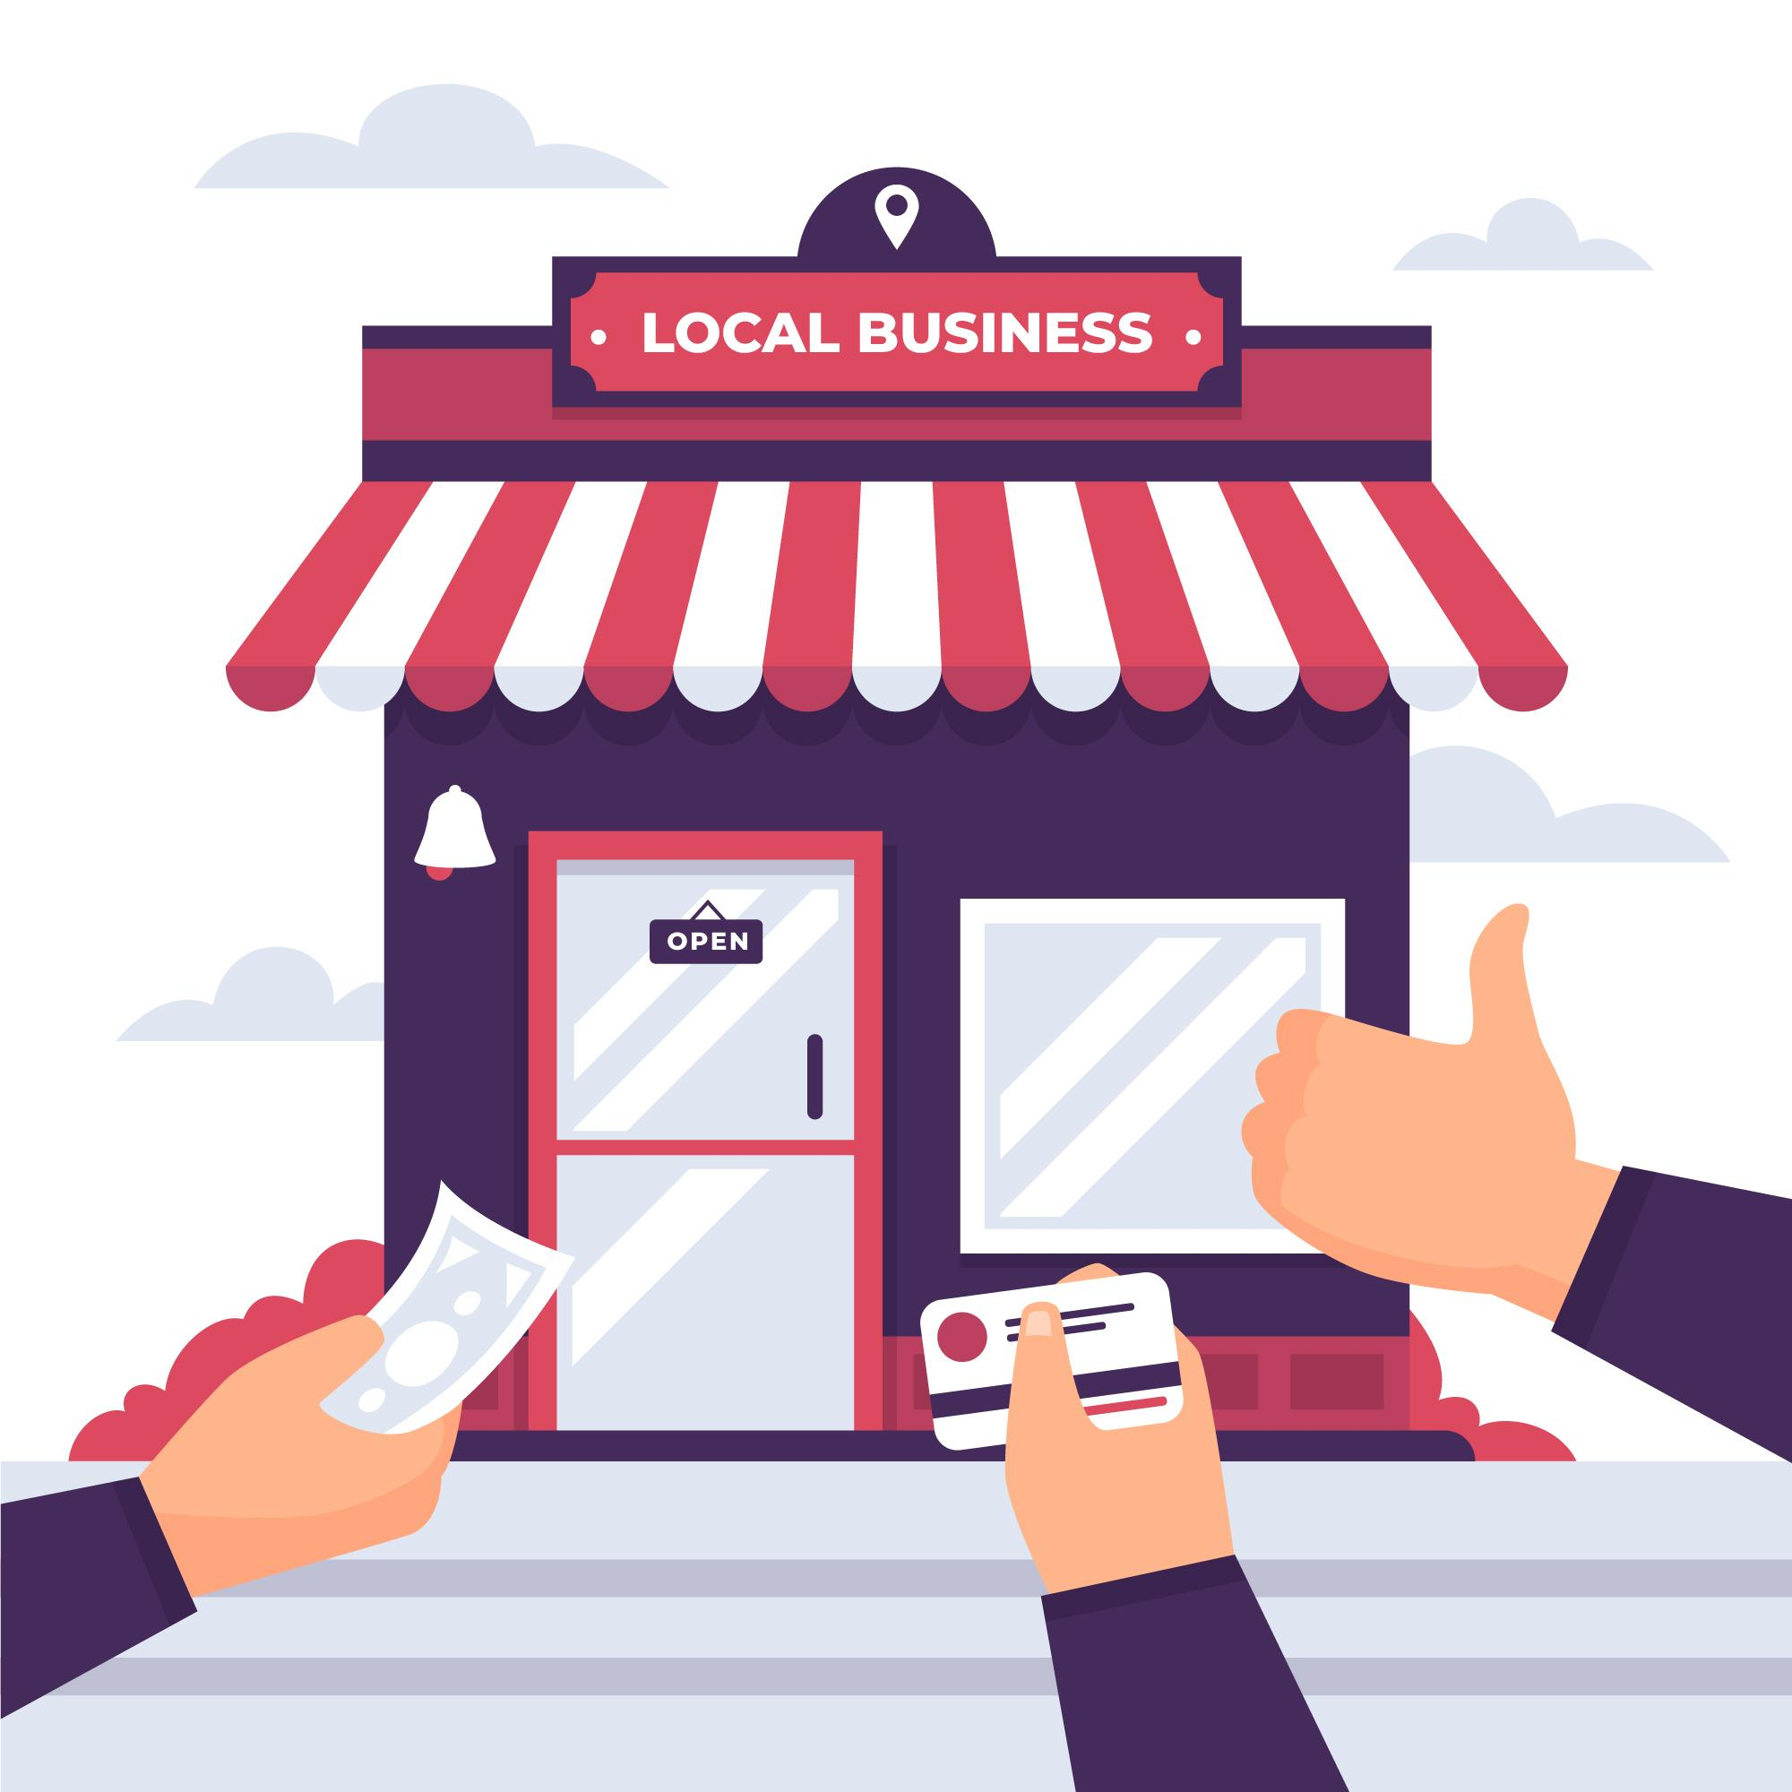
Learning Target
I will be able to explain what a business is
Understand Profit and why businesses are important
Differentiate between the four different types of businesses.

Slide 3

Do Now
What comes to mind when you hear “Types of Business”?

Slide 4
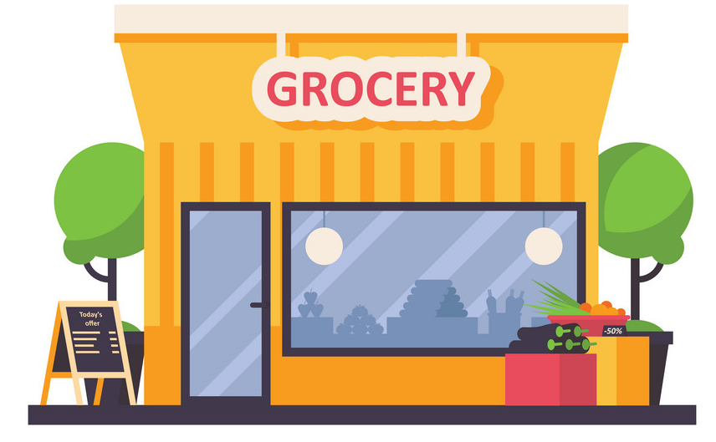
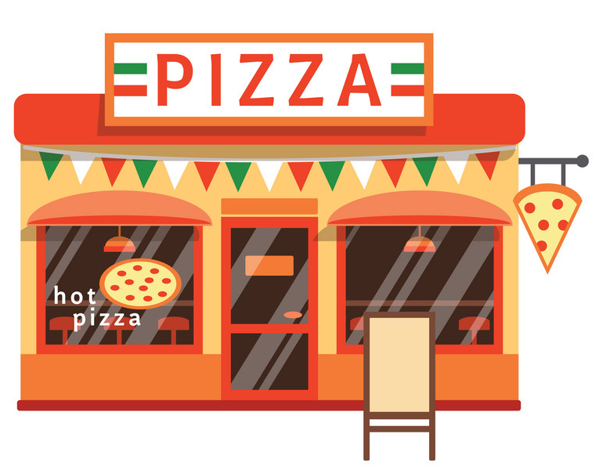
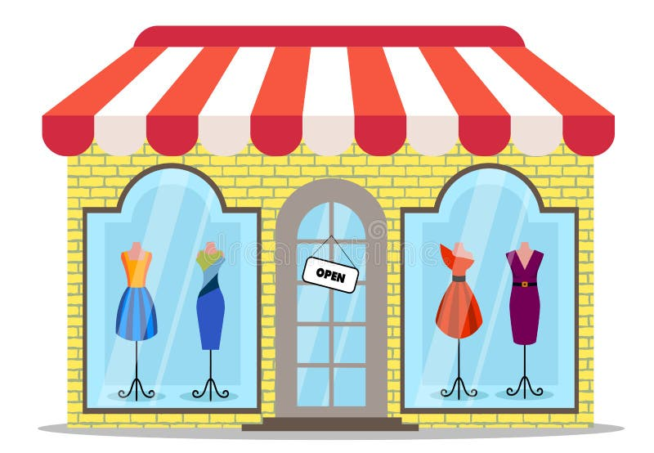
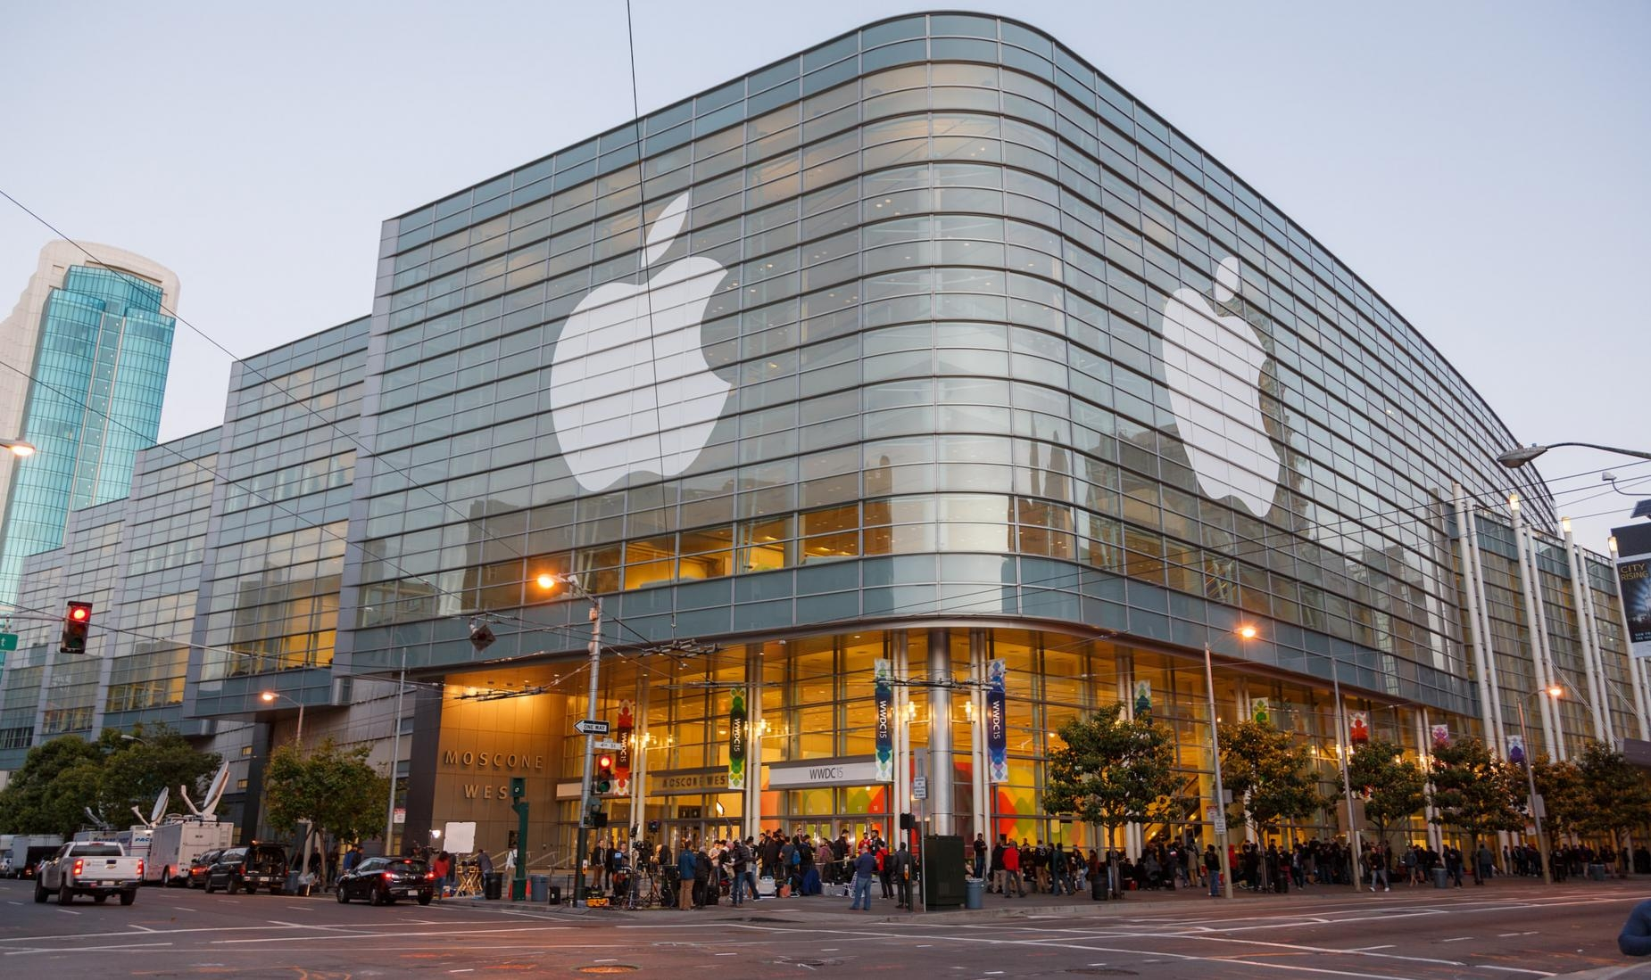
A local grocery store?
Your favorite pizzeria?
All of these organizations are examples of businesses!
A national clothing store?
A large technology company, like Apple?

Slide 5
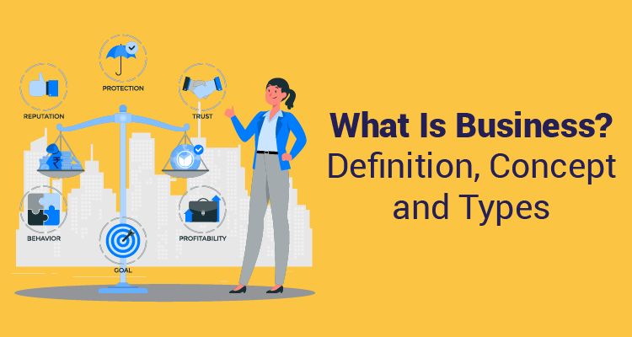

Slide 6

What is a Business?
Business: any organization or enterprise that provides and sells products to meet the wants and needs of customers

Slide 7
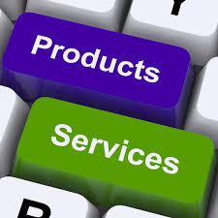

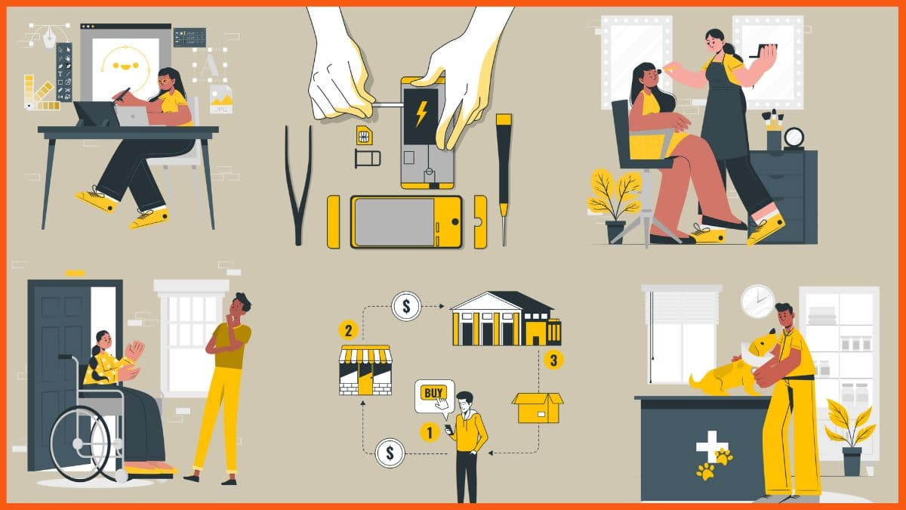
Businesses Sell Products Products can be a good, a service, or a combination of both
Goods: items sold that are tangible, meaning that you can physically touch/own them.
Examples?
Book, car, snacks
Services: you get paid to do something for someone. They are intangible meaning you can’t physically touch it.
Examples?
haircut, a concert, Uber ride

Slide 8
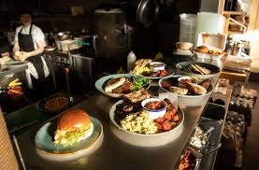
What can be a good And a service?
Going to a restaurant:
Good =
I get paid for the food = good
Service =
I get paid to cook and serve you food = Service

Slide 9


Table Talk Activity (Enter your answers in the Packet. We will discuss)
Like we did the restaurant activity, discuss with your table and list another business that can sell both a Good and a Service.
We will share in class

Slide 10
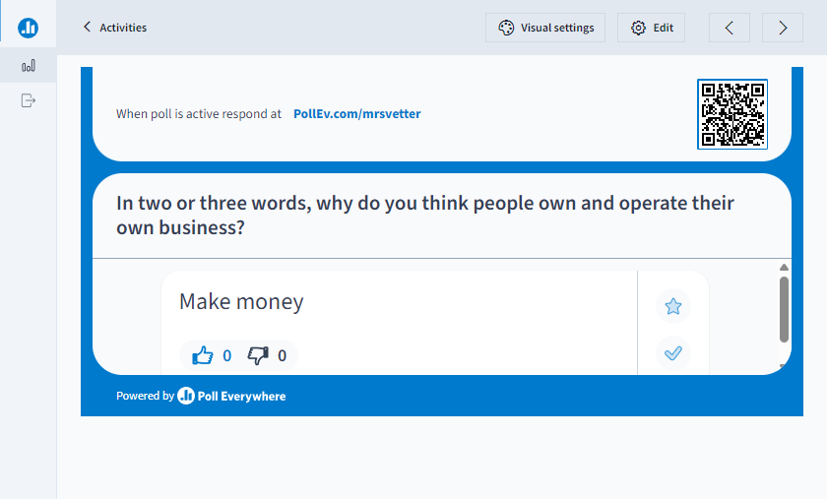
Why do people open and own their own business? (Add a Poll Everywhere slide here for them to use their phones and add their answers.

Slide 11
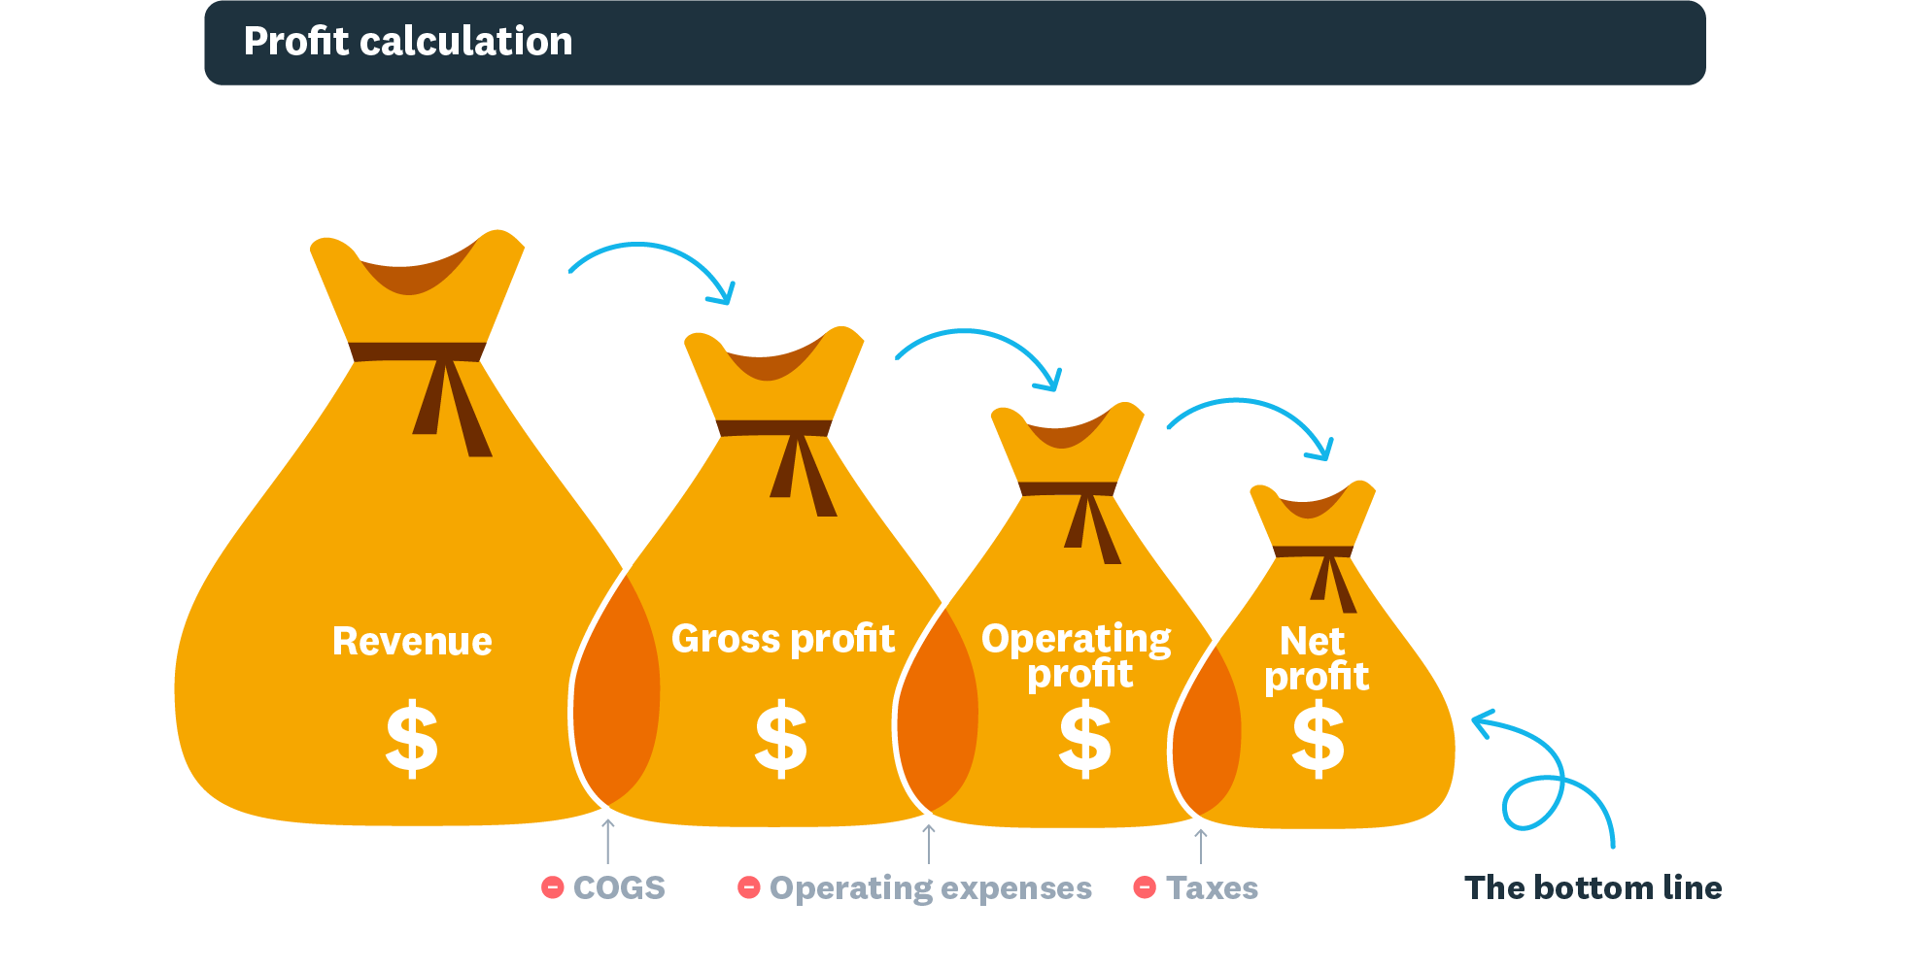
What is the Purpose of a Business?
Main Purpose = #1 Reason
provide products that people are willing to buy to earn a profit

Slide 12
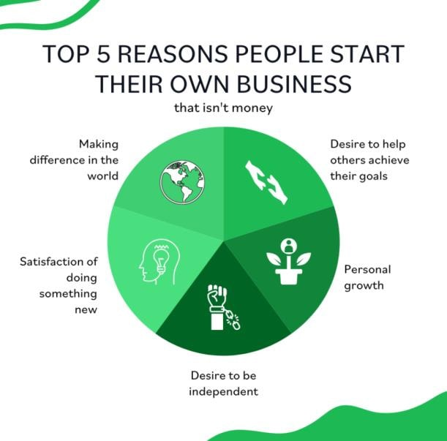
Other Purposes For starting a Business?
Directions: List the remaining reasons for owning a business in your packet. List them in order of what would be most important to you in owning a business
Mrs. Vetter’s list of importance:
To Earn a Profit
Want to be independent
Help others achieve their goals by Creating jobs
Personal Growth
Making a difference in the world
Creating innovative products

Slide 13

Quick Write Activity
List why you chose “Your Top” two in the Quick Write Activity section of the packet.

Slide 14

What is Profit?
Profit: the difference between revenue of a business and its expenses
Said another way: It is the amount of money you made from what you sold after you paid for all the costs/expenses

Slide 15

Calculating Profit
Subtract the expenses of the business from its total revenue
Profit = Total Revenue – Total Expenses/Costs

Slide 16
Calculate your Profit?
Your Revenue for the day was $2000, your expenses were $1200. How much is your profit
$800

Slide 17
What is Profit?
Your Revenue for the day was $200,000 and your costs were $157,450. How much is your profit
$42,550

Slide 18


Assignment:
1. Complete the Quick Write section of your Activity packet on the bottom of page 2.
2. Go to Google Classroom and complete the Quizziz Assignment: What is a Business Chapter 1-1

Slide 19
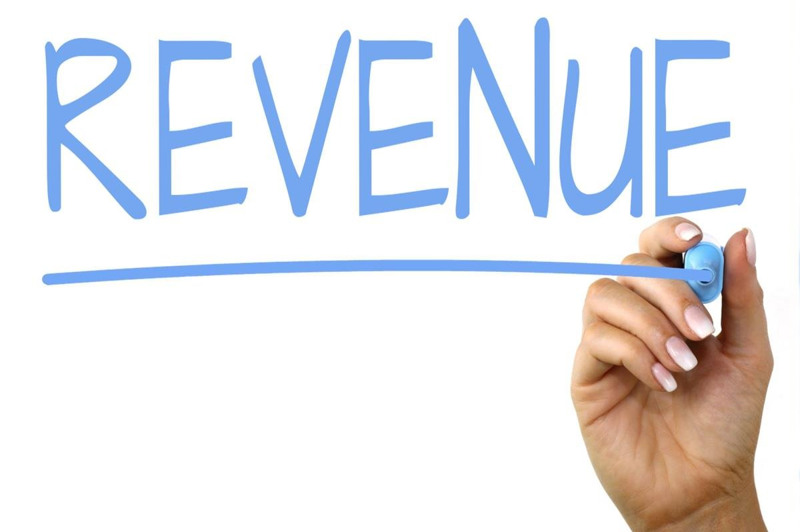
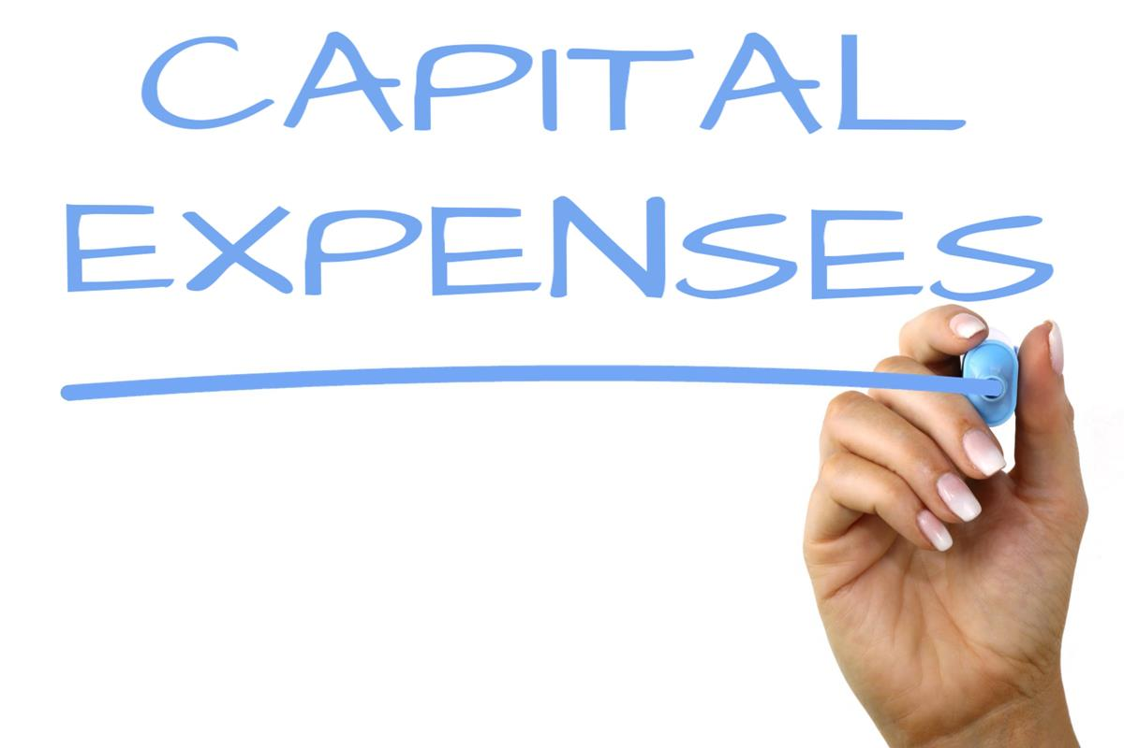
What is Revenue
&
This Photo by Unknown Author is licensed under CC BY-SA
This Photo by Unknown Author is licensed under CC BY-SA

Slide 20
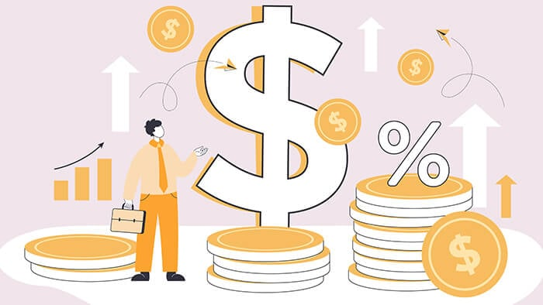
What is Revenue?
Revenue: funds that flow into a business from its primary activity, such as the sale of products

Slide 21
Businesses earn revenue from various sources
What is the Primary Source of Revenue?
Total from the sales of goods or services
Other Sources
Subscriptions based pricing
Licensing – sell their copyrighted materials
Advertising and Sponsorships
Interest on their investments

Slide 22
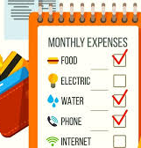
Sources of Expenses?
Expenses: costs incurred by a business in the process of generating revenue
Some common Examples include:
Cost to producing products or buying products to sell
Labor costs
Rent/Mortgage
Utilities (lights, heat, water etc…)
Advertising
Insurance
Taxes

Slide 23
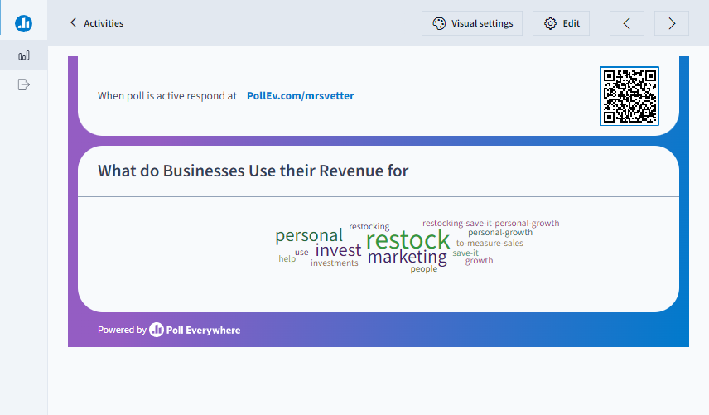

Slide 24

How Do Businesses Use Their Profits?
Various Ways:
Investing in R&D - research and development (New products)
Rewarding owners and shareholders
Expanding operations (global)
Investing in marketing
Repaying any debts
Improving employee compensation
Supporting social and environmental initiatives
Reinvesting in the business

Slide 25
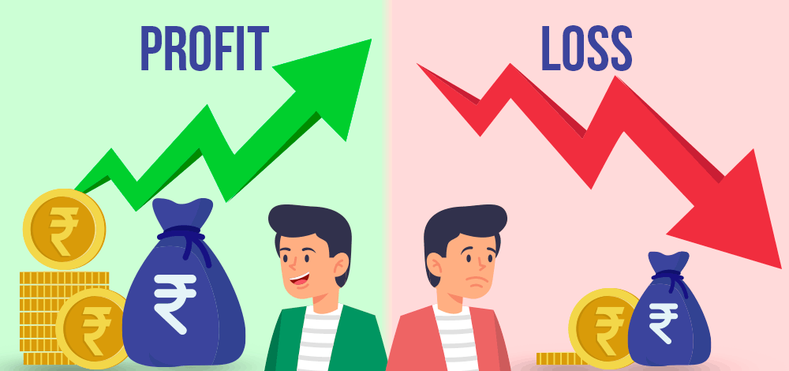
Profit: When a business earns more than they spend
(More Revenue than Expenses)
Loss: When a business spends more than
they earn
(More Expenses than Revenue)
I am smiling
I am frowning

Slide 26
Assignment
1. Complete the Quick Write Activity in your packet.
2. Complete the Google Classroom Assignment Posted on Google Classroom: Profit and Loss Digital Math Activity

Slide 27

Earning a profit is not necessary for an organization to be considered a business. Just the pursuit of profit makes an organization a business

Slide 28
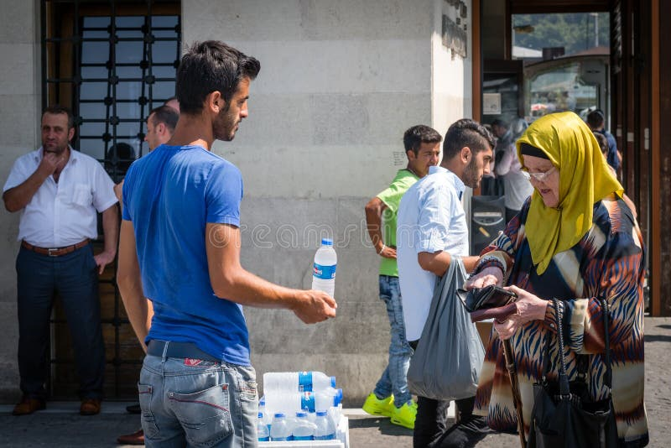

In addition, an organization does not need to have a physical store, or even a website, to be considered a business
A person selling water outside on a hot day is doing business, as they are offering a product in exchange for a profit
A self-employed worker who offers their video editing skills on a freelance basis could be a business within themselves

Slide 29

What are the Benefits of Business in Society?
Businesses Create:
Job creation
Drive innovation and new technological advancement - improves the quality of life and enhance productivity
Create wealth for their owners, shareholders, and employees (moves the economy)
Offer a wide range of products for lower prices
Support various social and environmental causes

Slide 30

What are the Drawbacks of Business in Society?
Some businesses can have:
a negative environmental impacts, such as pollution and greenhouse gas emissions
Poor working conditions, inadequate wages, or unethical labor practices
Sale of products that are hazardous
Engage in unethical behavior, such as tax evasion and corporate scandals
Large businesses can have significant market power, leading to a monopoly that hinders fair competition and limits consumer choices

Slide 31
Quick Write Activity
Read the article exert below and answer the question in your packet:
Texas Attorney General sued General Motors Tuesday, alleging the carmaker illegally collected and sold drivers’ data to insurance companies
In car models from 2015 and later, the Detroit-based car manufacturer allegedly used technology to “collect, record, analyze, and transmit highly detailed driving data about each time a driver used their vehicle,”

Slide 32
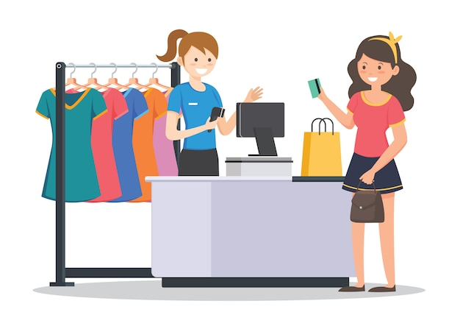


Types/Categories of Businesses
There are many types of businesses, and it is common for businesses to operate in multiple areas simultaneously. But there are four main categories of FOR PROFIT businesses.

Slide 33
Manufacturing
a business that develop a product and sell it either directly to the customer or to some type of middleman, like a wholesaler or retailer
Merchandising
also known as retailing,
Products are purchased from manufacturers, wholesalers, or other middlemen, and are sold at the retail price to the consumer
Sell products at a price higher than what they paid to purchase to earn a profit
Service Business
Sell intangible goods to consumers. They are paid to do something for the customer. They offer professional services, expertise, and various other offerings.
Hybrid
Businesses that possess the qualities of multiple business types. They can be a manufacturer, merchandiser, and/or service business.
Four Main Types of Businesses Include

Slide 34
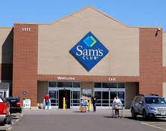
Example: Sam’s Club
manufactures its own line of products branded Member’s mark
They sell their products and products from other manufactures/wholesalers
Offers a variety of services including health care services, travel, auto maintenance etc.

Slide 35
Directions:
From the List of well-known companies provided by your instructor, determine whether each is predominately a manufacturing, merchandising, service, or hybrid business. If it is hybrid, state which two or three types it is.

Slide 36
Table Talk Group Activity: Types of Businesses
Directions: Given the list of well-known companies, determine whether each is predominately a manufacturing, merchandising, service, or hybrid business. If it is hybrid, state which two or three types it is.
Apple
Boeing
Coca-Cola
CVS
Delta Airlines
Disney
FedEx
Ford
Amazon
Google
H&R Block
Johnson & Johnson
McDonald’s
Netflix
Wal-Mart

Slide 37
Crossword
Complete the Crossword Puzzle in your Activity Packet

Slide 38
non-profit - is a group organized for purposes other than generating profit
Not all businesses are created to earn a profit but to make a difference.
What are these types of Businesses known as?

Slide 39


Organizations that operate for NON-Profit fall into one of those two categories
Government Organizations
Nonprofit Organizations

Slide 40

Government Organizations - Local, state, and federal government organizations exist to provide public services
Examples:
enforce laws
manage public resources
primary goal is to serve the interests of citizens rather than generating profits

Slide 41
Nonprofit Organizations
Nonprofit organizations - operate for charitable or social purposes
Examples: provide services such as healthcare, education, and community development.
Their funding comes from donations, grants, and fundraising rather than generating profits from business activities

